Slide 1
Linear Regression
Session 05-06

Slide 2
Learning Outcome
LO 1: Explain the fundamental of machine learning concept
LO 2: Interpret the distribution of dataset using regression method
LO 3: Experiment classification and clustering algorithm from given dataset

Slide 3
Outline
Introduction
Linear Regression – Model
Feature Mapping
Model Complexity
Finding the weight in Linear Regression
Evaluation Metric

Slide 4
Introduction

Slide 5
Introduction
Linear Regression is a statistical supervised learning technique to predict the quantitative variable by forming a linear relationship with one or more independent features.
It helps determine:
If a independent variable does a good job in predicting the dependent variable.
Which independent variable plays a significant role in predicting the dependent variable

Slide 6
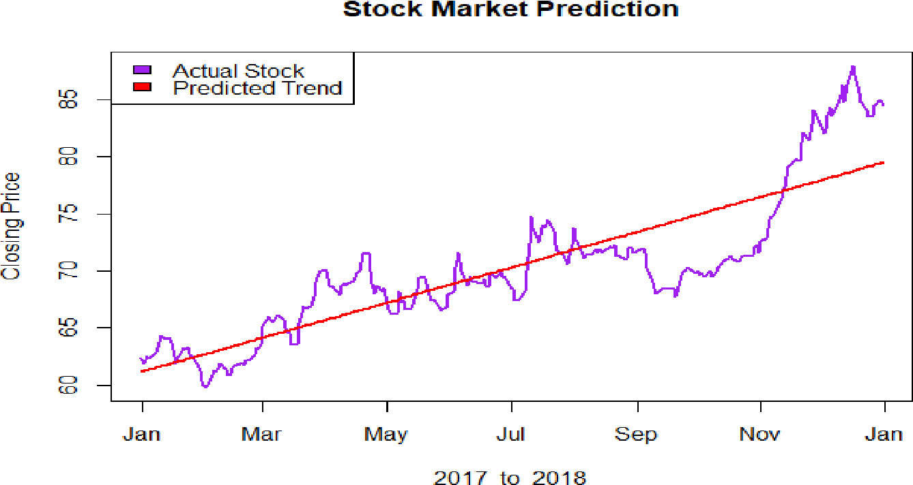
Introduction
The Application of Linear Regression
Applications and Approaches of Linear Regression:
Stock Prediction

Slide 7
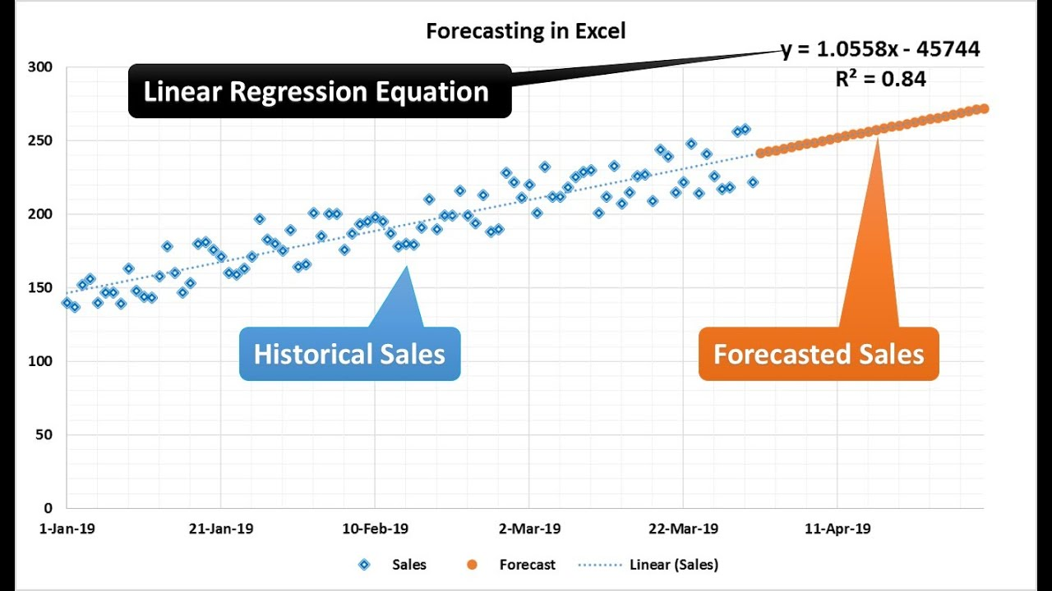
Introduction
The Application of Linear Regression
Applications and Approaches of Linear Regression:
Predict future prices/costs

Slide 8
Linear Regression -Model

Slide 9
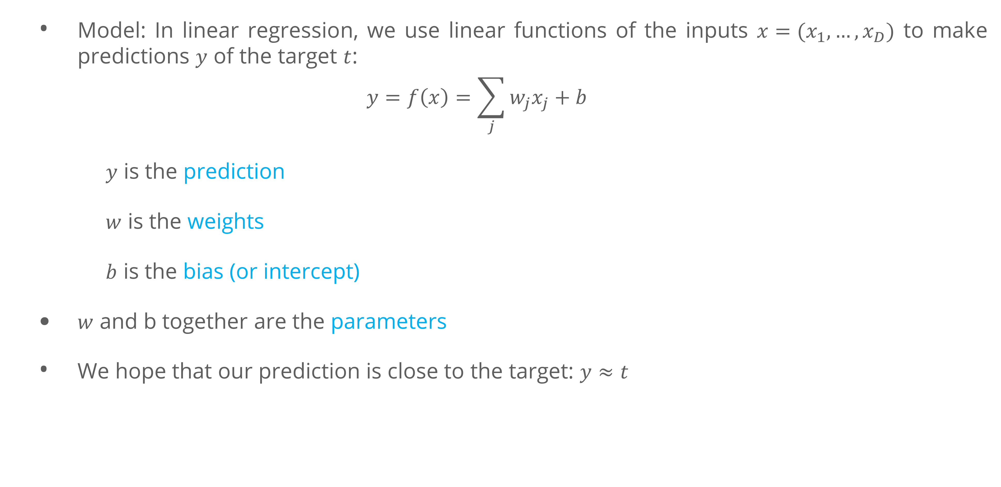
Linear Regression-Model
Model: In linear regression, we use linear functions of the inputs $x=(x_{1},…, x_{D})$ to make predictions $y$ of the target $t$:
$$y=f\left(x\right)=\sum_{j}{w_{j}x_{j}}+b$$
$y$ is the prediction
$w$ is the weights
$b$ is the bias (or intercept)
$w$ and b together are the parameters
We hope that our prediction is close to the target: $y≈t$

Slide 10
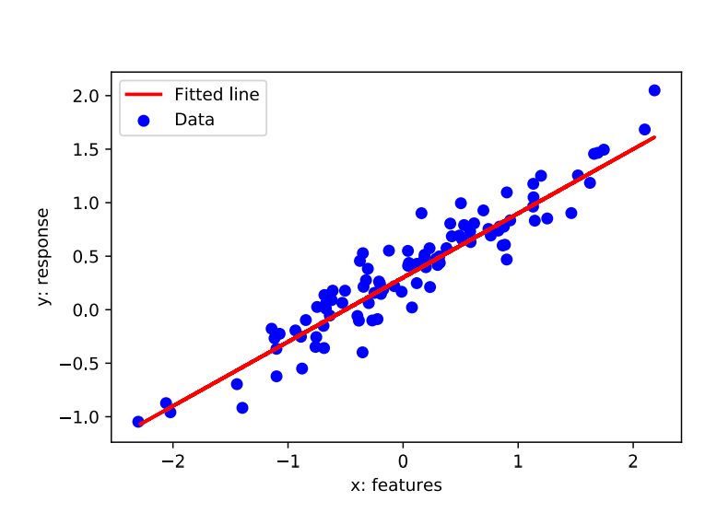
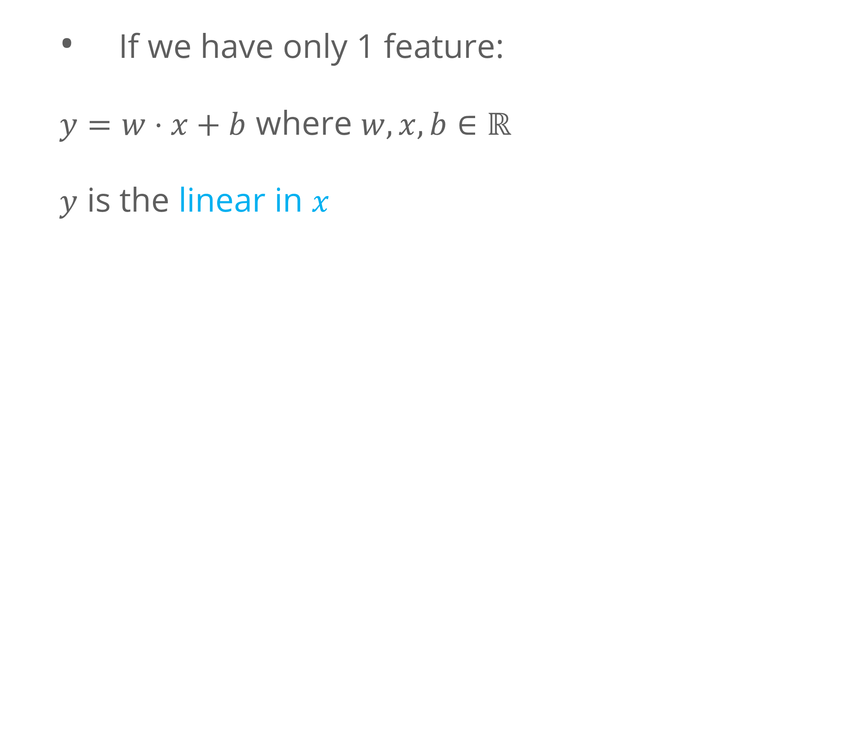
Linear Regression-Model
What is Linear ? 1 Feature vs D. Features
If we have only 1 feature:
$y=w⋅x+b$ where $w,x,b∈ℝ$
$y$ is the linear in $x$

Slide 11
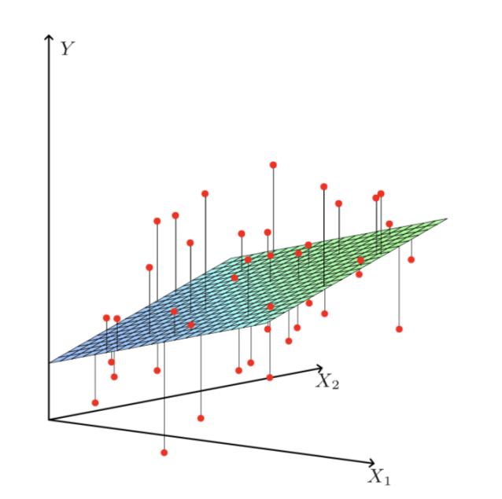
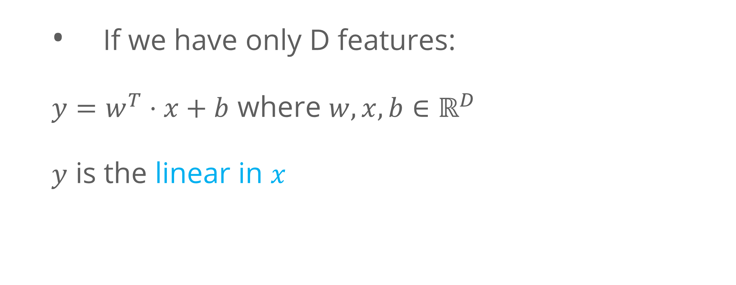
Linear Regression-Model
What is Linear ? 1 Feature vs D. Features
If we have only D features:
$y=w^{T}⋅x+b$ where $w,x,b∈ℝ^{D}$
$y$ is the linear in $x$

Slide 12
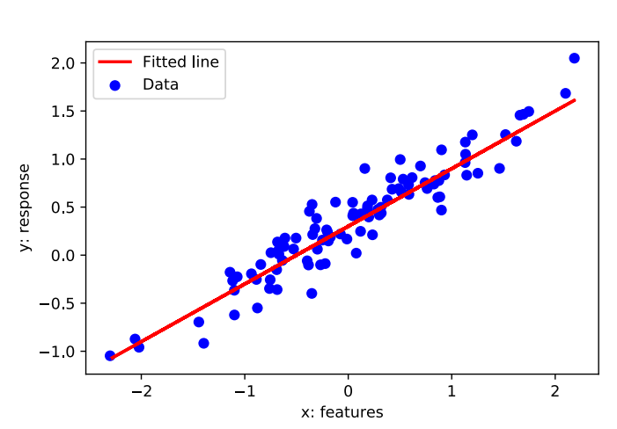
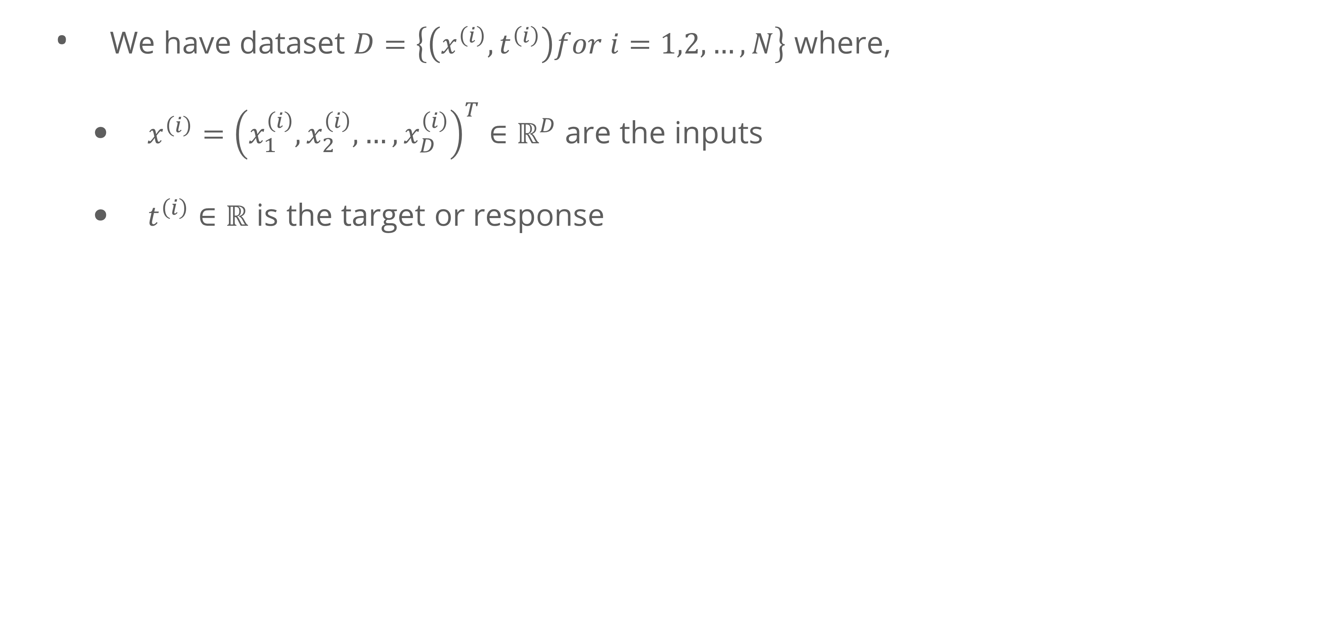
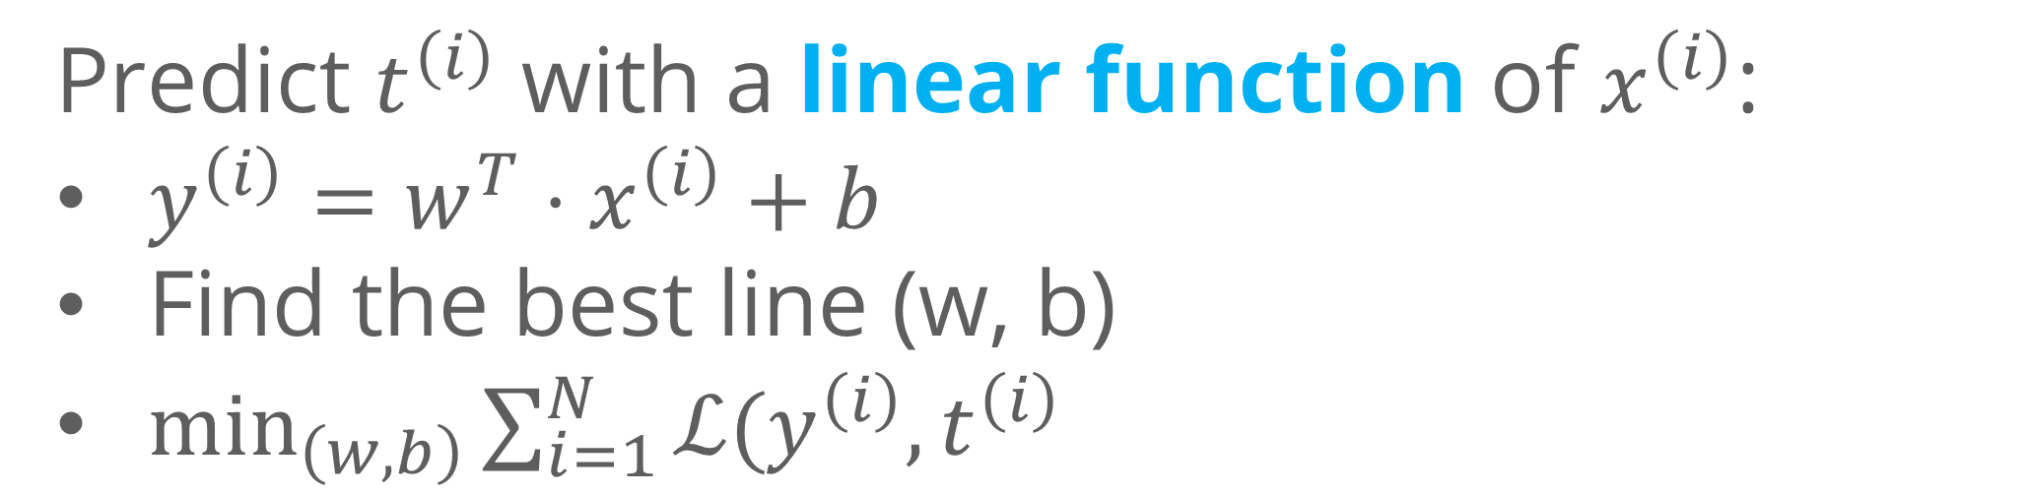
Linear Regression-Model
We have dataset $D=\left\{\left(x^{\left(i\right)}, t^{\left(i\right)}\right)for i=1,2,…, N\right\}$ where,
$x^{\left(i\right)}={\left(x_{1}^{\left(i\right)},x_{2}^{\left(i\right)},…, x_{D}^{\left(i\right)}\right)}^{T}∈ℝ^{D}$ are the inputs
$t^{\left(i\right)}∈ℝ$ is the target or response
Predict $t^{\left(i\right)}$ with a linear function of $x^{\left(i\right)}$:
$y^{\left(i\right)}=w^{T}⋅x^{\left(i\right)}+b$
Find the best line (w, b)
$\min_{\left(w,b\right)}{\sum_{i=1}^{N}{ℒ(y^{\left(i\right)}, t^{\left(i\right)}}}$

Slide 13
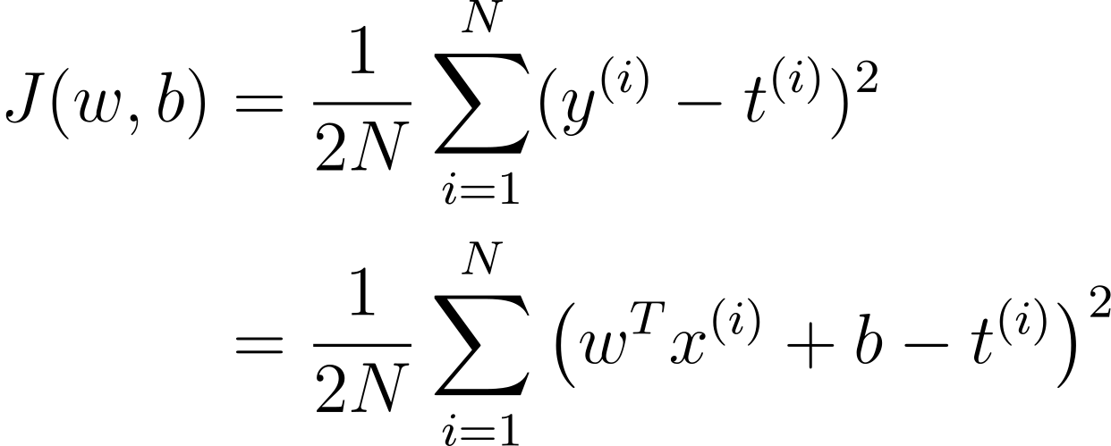
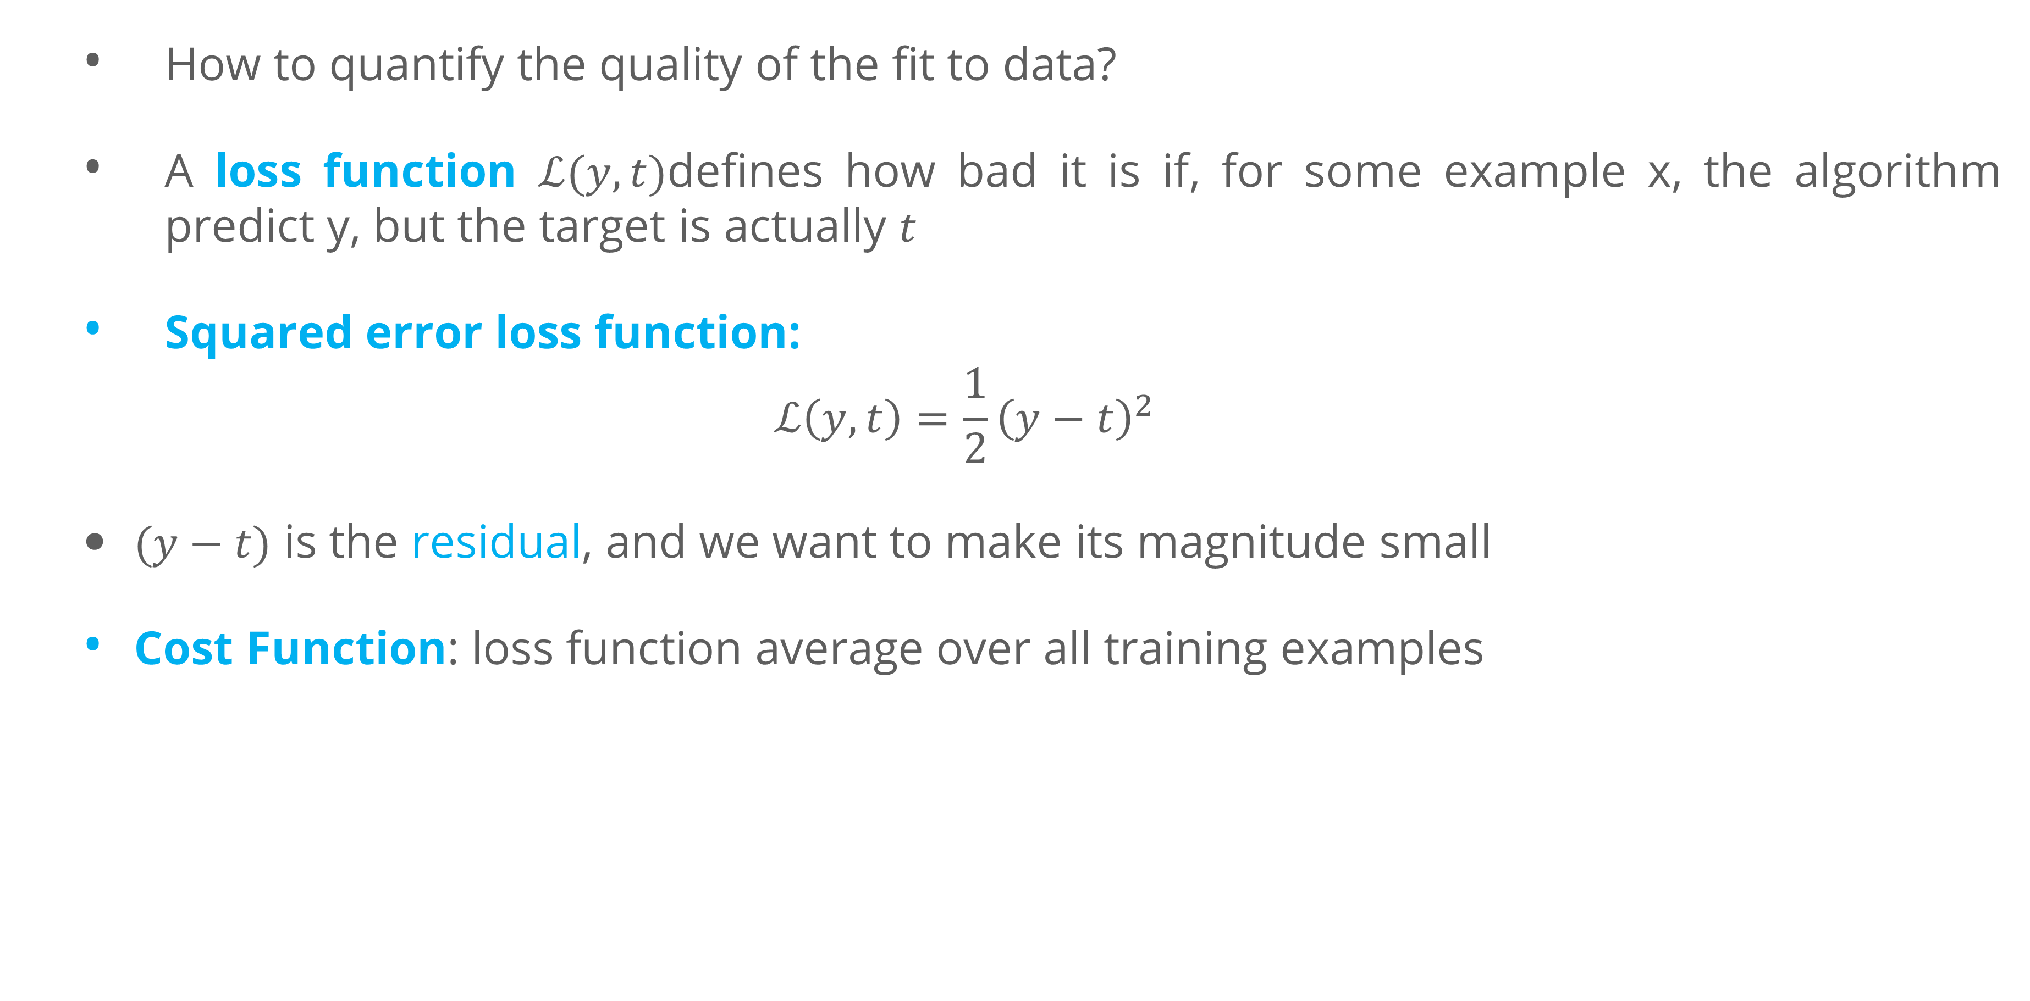
Linear Regression-Model
Loss Function
How to quantify the quality of the fit to data?
A loss function $ℒ(y,t)$defines how bad it is if, for some example x, the algorithm predict y, but the target is actually $t$
Squared error loss function:
$$ℒ\left(y,t\right)=\frac{1}{2}{\left(y−t\right)}^{2}$$
$(y−t)$ is the residual, and we want to make its magnitude small
Cost Function: loss function average over all training examples

Slide 14
Feature Mapping

Slide 15
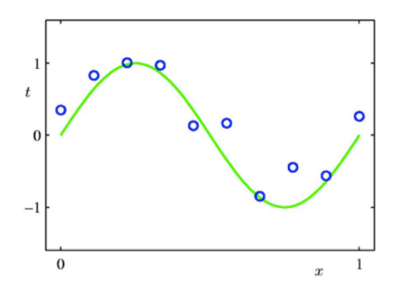
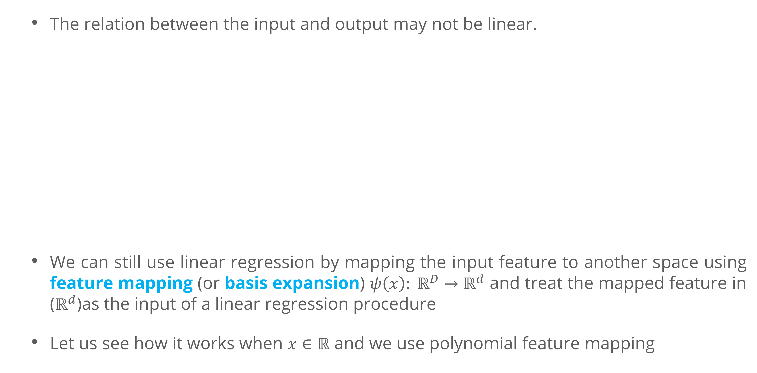
Feature Mapping
The relation between the input and output may not be linear.
We can still use linear regression by mapping the input feature to another space using feature mapping (or basis expansion) $ψ\left(x\right): ℝ^{D}→ℝ^{d}$ and treat the mapped feature in ($ℝ^{d}$)as the input of a linear regression procedure
Let us see how it works when $x∈ℝ$ and we use polynomial feature mapping

Slide 16
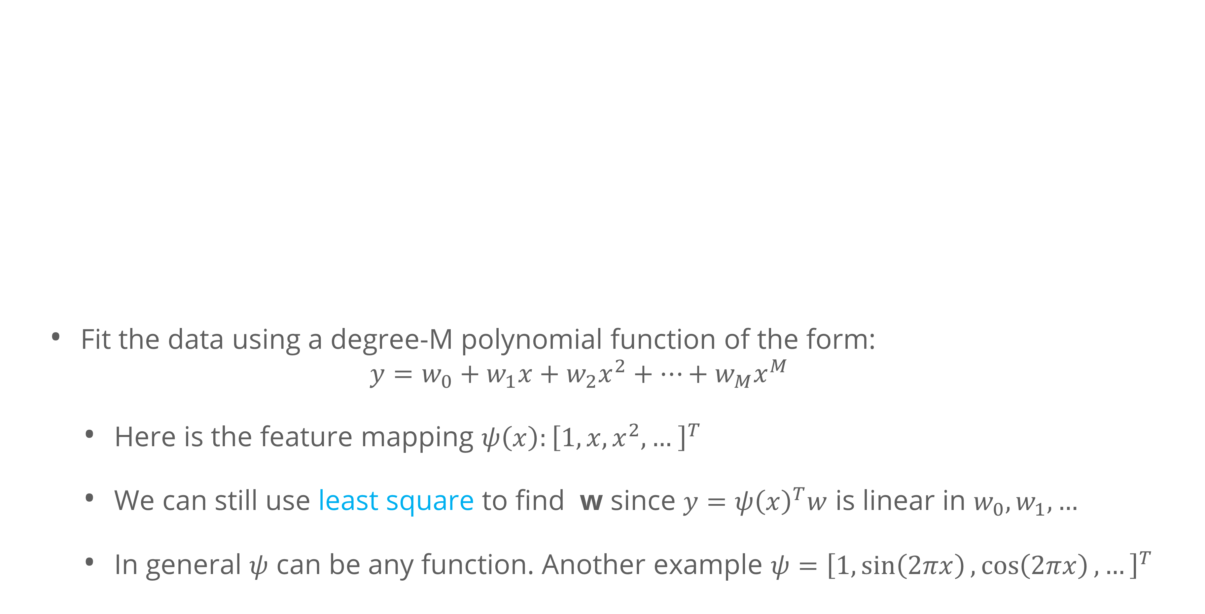
Feature Mapping
Fit the data using a degree-M polynomial function of the form:
$$y=w_{0}+w_{1}x+w_{2}x^{2}+…+w_{M}x^{M}$$
Here is the feature mapping $ψ\left(x\right):{\left[1, x, x^{2},… \right]}^{T}$
We can still use least square to find w since $y=ψ{\left(x\right)}^{T}w$ is linear in $w_{0},w_{1},…$
In general $ψ$ can be any function. Another example $ψ={\left[1,\sin\left(2πx\right),\cos\left(2πx\right), …\right]}^{T}$

Slide 17
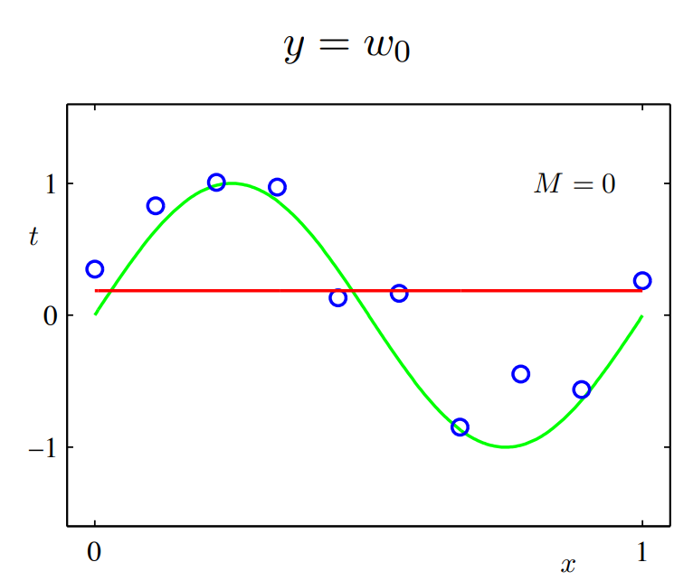
Feature Mapping
Polynomial Feature Mapping with M = 0

Slide 18
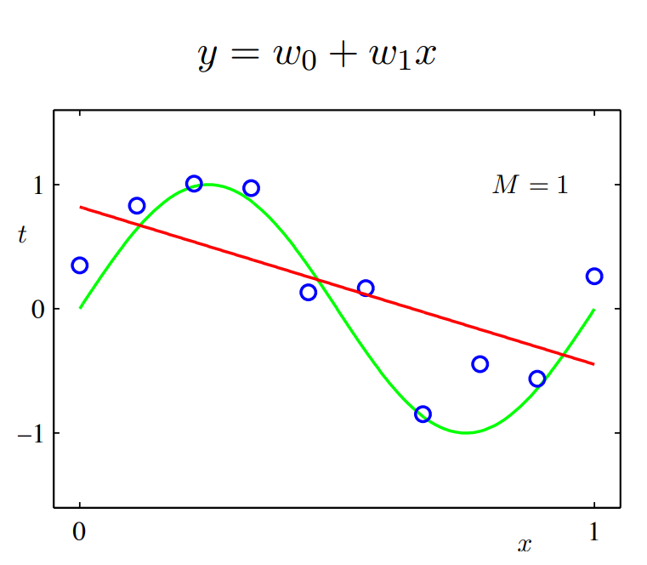
Feature Mapping
Polynomial Feature Mapping with M = 1

Slide 19
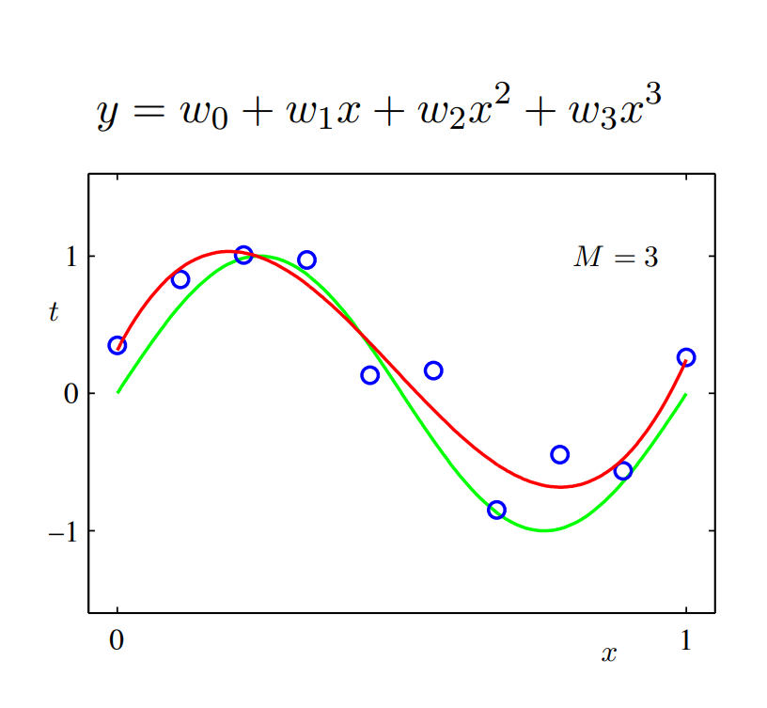
Feature Mapping
Polynomial Feature Mapping with M = 3

Slide 20
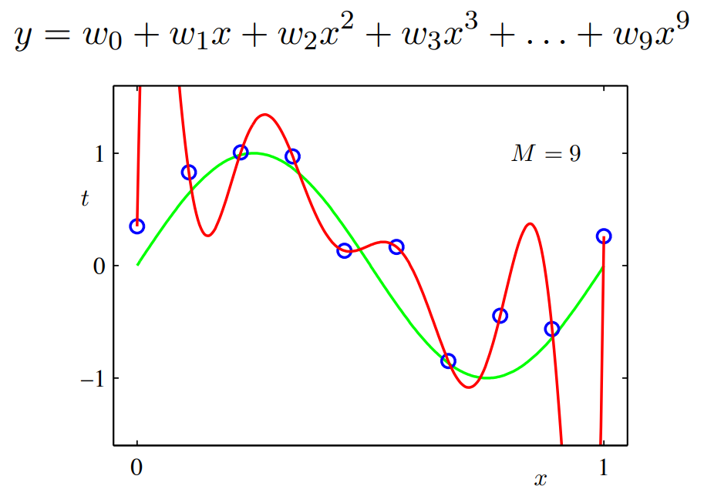
Feature Mapping
Polynomial Feature Mapping with M = 9

Slide 21
Model Complexity and Generalization

Slide 22
Model Complexity and Generalization
Underfitting (M=0): model is too simple — does not fit the data.
Overfitting (M=9): model is too complex — fits perfectly
Good model (M=3): Achieves small test error (generalizes well).
Underfitting
Overfitting
Good model

Slide 23
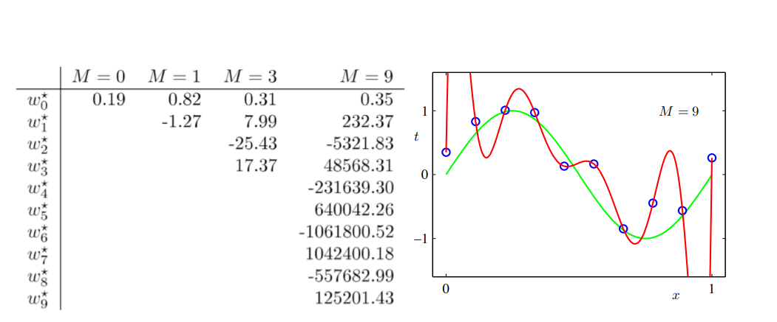
Model Complexity and Generalization
As M increases, the magnitude of coefficients gets larger
For M=9, the coefficients have become finely tuned to the data.
Between data points, the function exhibits large oscillations.

Slide 24
Finding the Weight

Slide 25
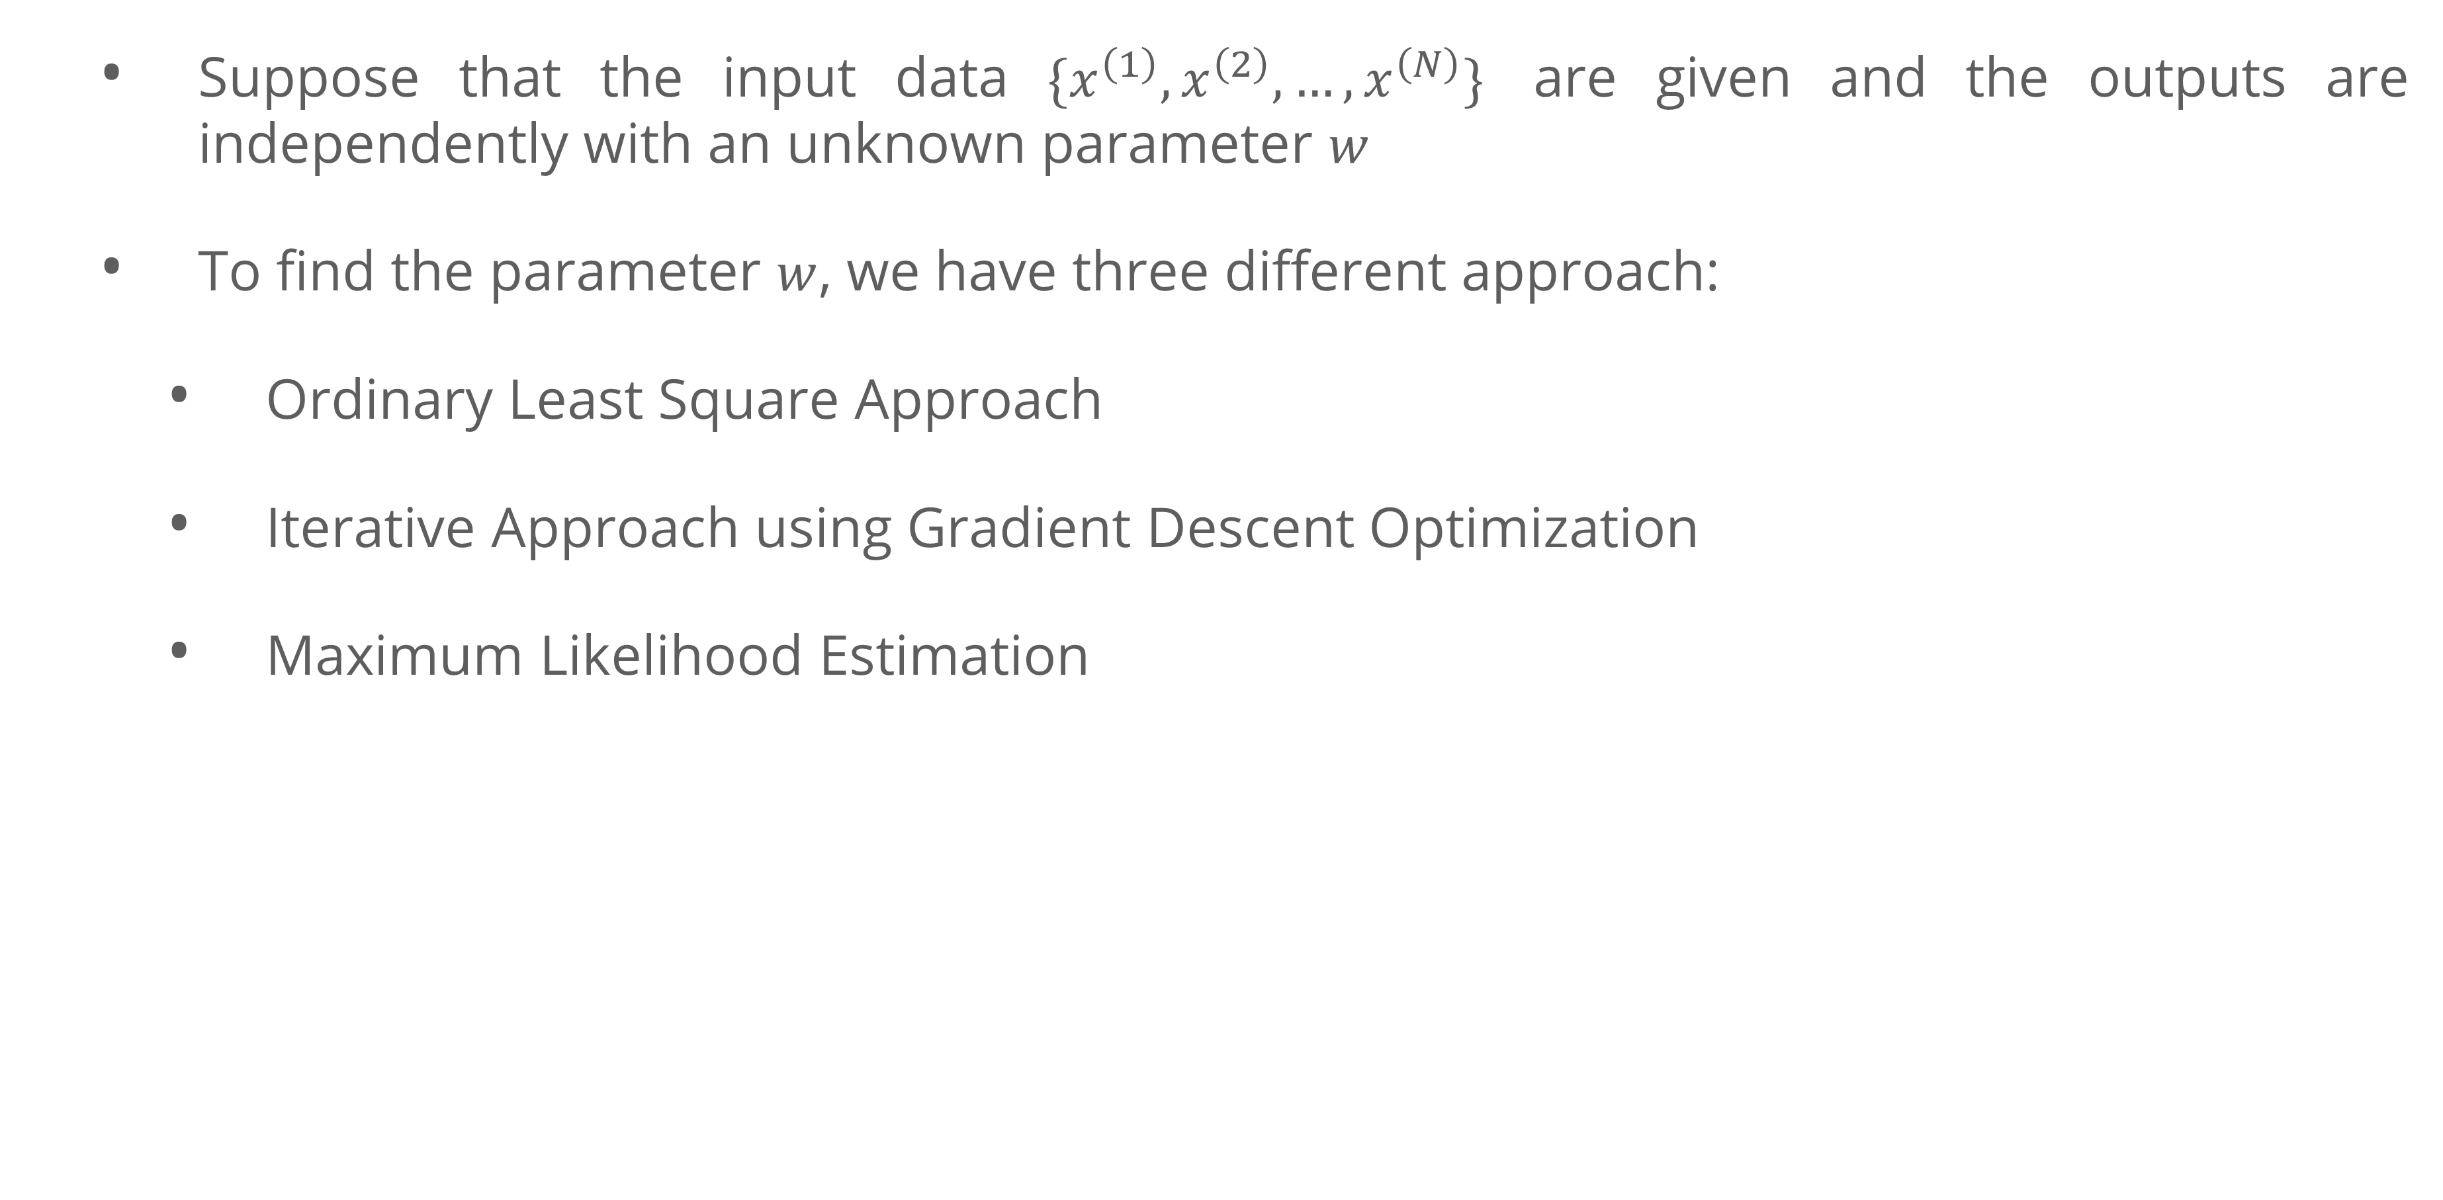
Finding the weight
Suppose that the input data $\{x^{\left(1\right)},x^{\left(2\right)}, …, x^{\left(N\right)}\}$ are given and the outputs are independently with an unknown parameter $w$
To find the parameter $w$, we have three different approach:
Ordinary Least Square Approach
Iterative Approach using Gradient Descent Optimization
Maximum Likelihood Estimation
Focused in this Session

Slide 26
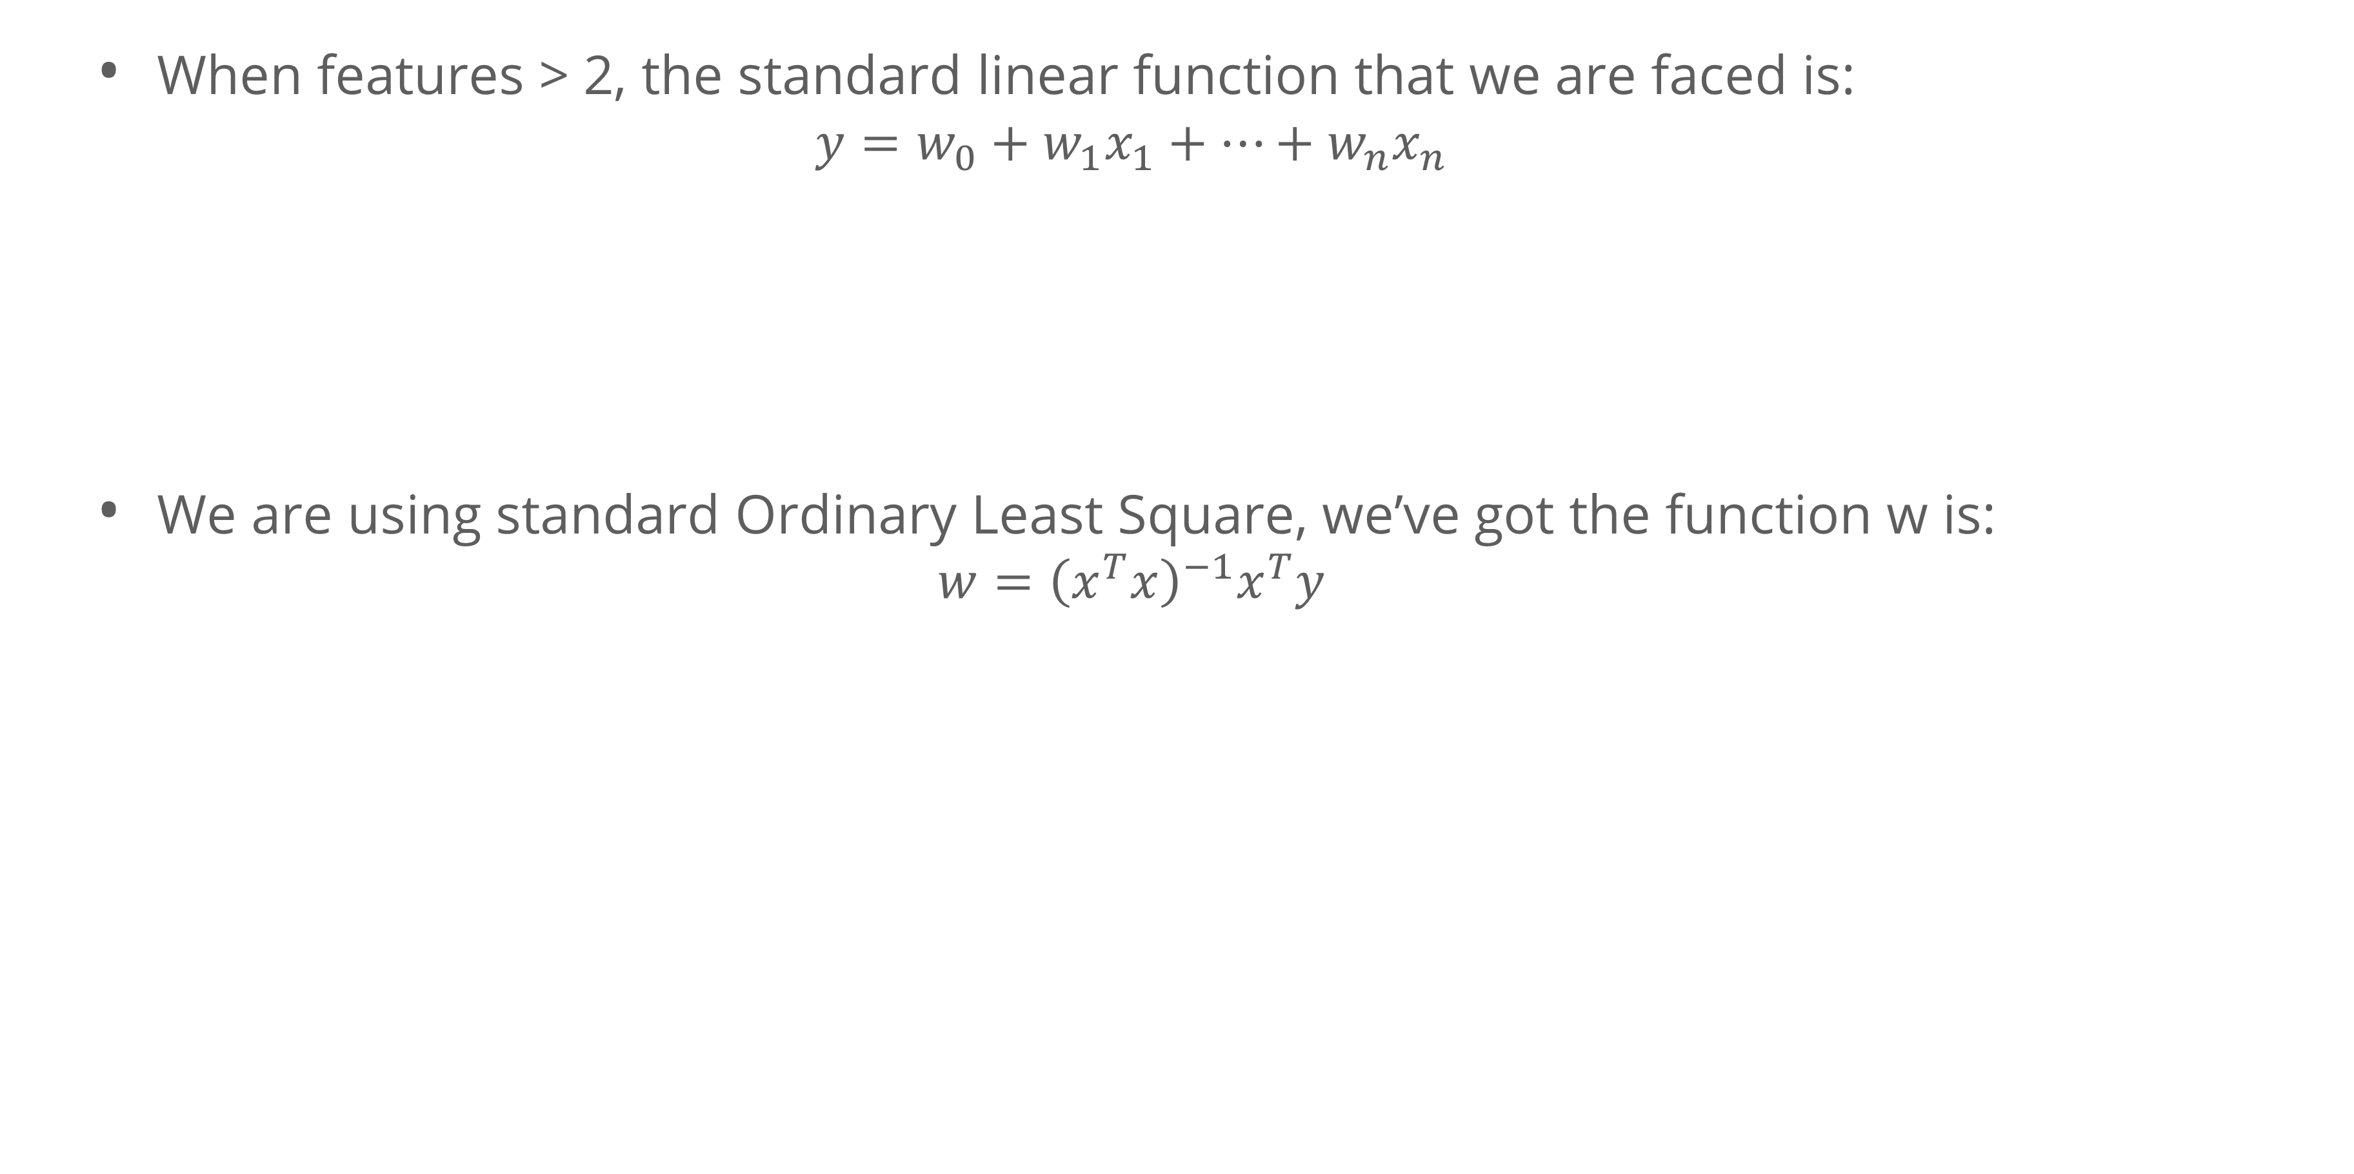
Finding the weight
Ordinary Least Square
When features > 2, the standard linear function that we are faced is:
$$y=w_{0}+w_{1}x_{1}+…+w_{n}x_{n}$$
We are using standard Ordinary Least Square, we’ve got the function w is:
$$w={\left(x^{T}x\right)}^{−1}x^{T}y$$

Slide 27
Finding the weight
Gradient Descent
Now let’s see a second way to minimize the cost function which is more broadly applicable: gradient descent.
Gradient descent is an iterative algorithm, which means we apply an update repeatedly until some criterion is met.
We initialize the weights to something reasonable (e.g. all zeros) and repeatedly adjust them in the direction of steepest descent.

Slide 28
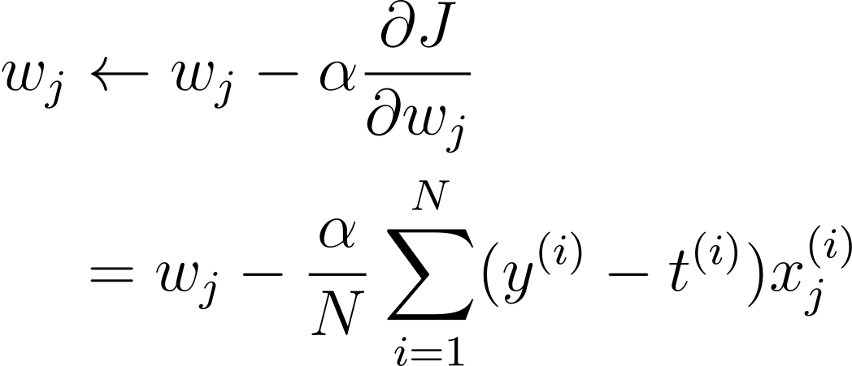
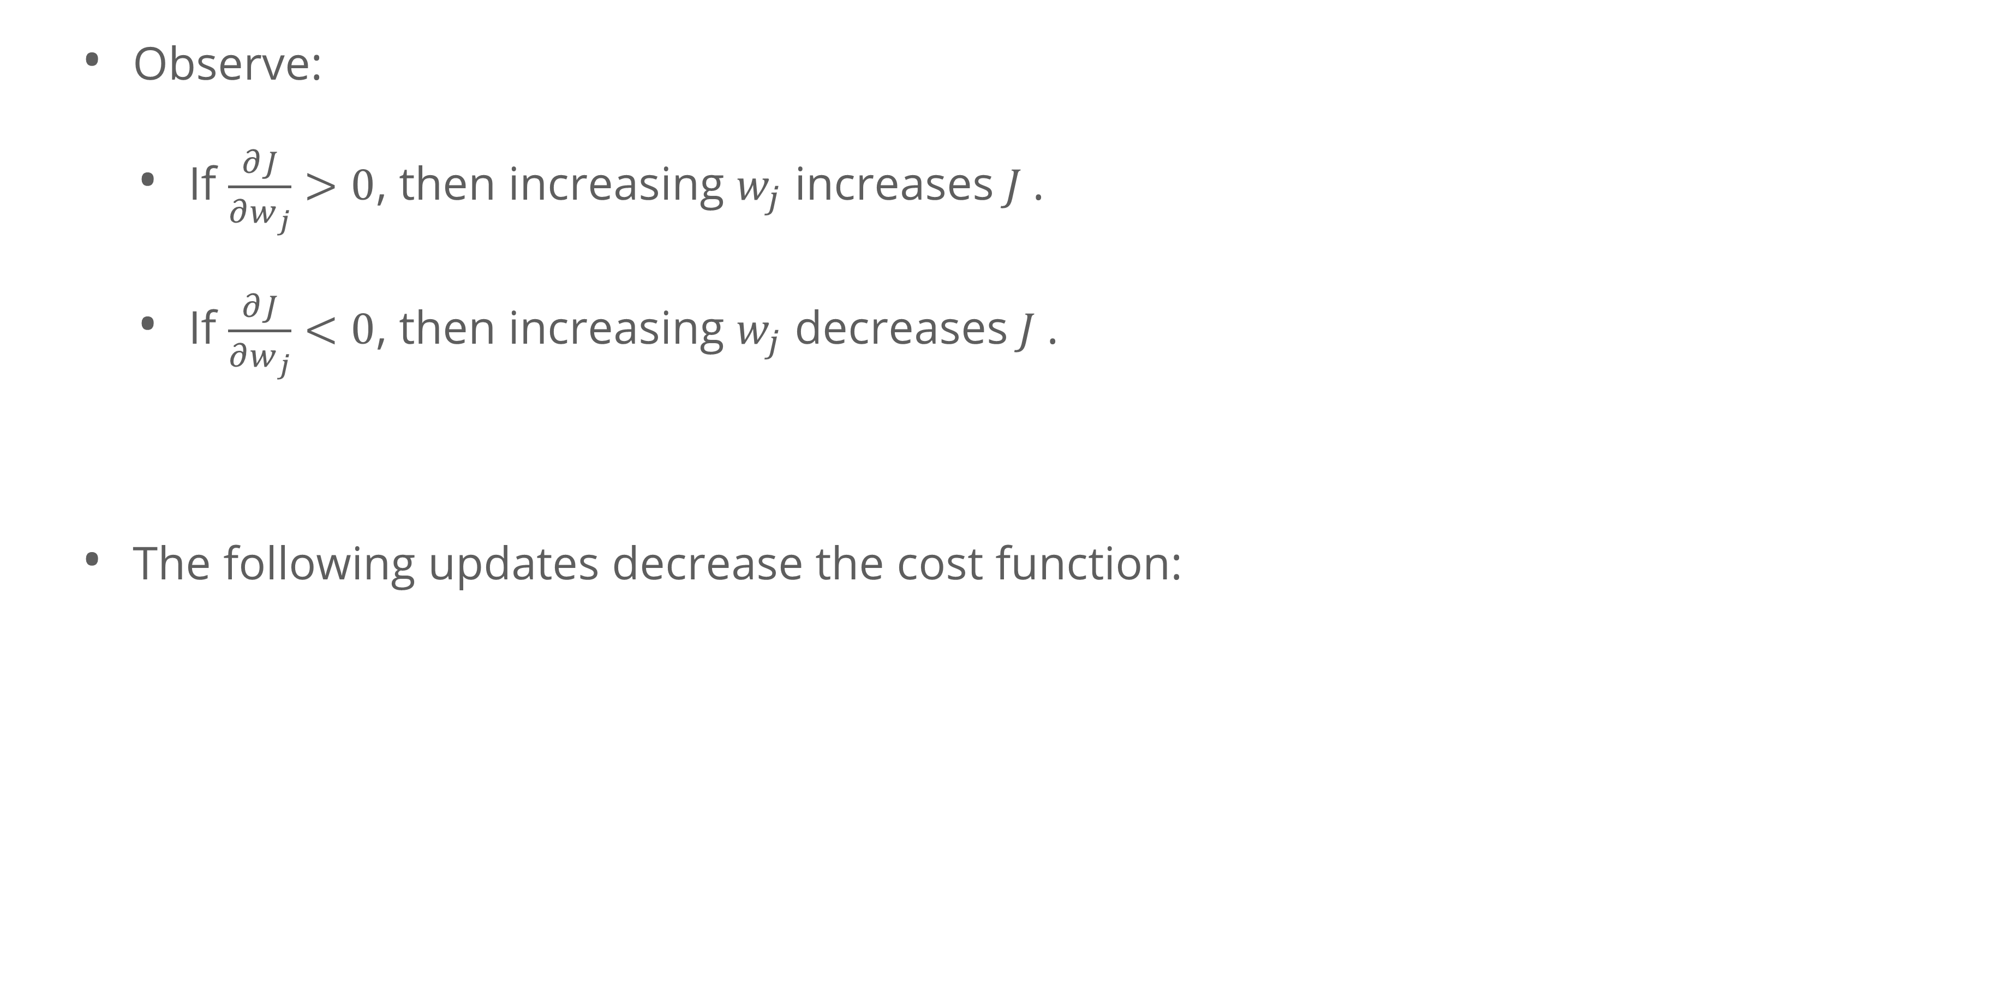
Finding the weight
Gradient Descent
Observe:
If $\frac{∂J}{∂w_{j}}>0$, then increasing $w_{j}$ increases$J$.
If $\frac{∂J}{∂w_{j}}<0$, then increasing $w_{j}$ decreases$J$.
The following updates decrease the cost function:

Slide 29
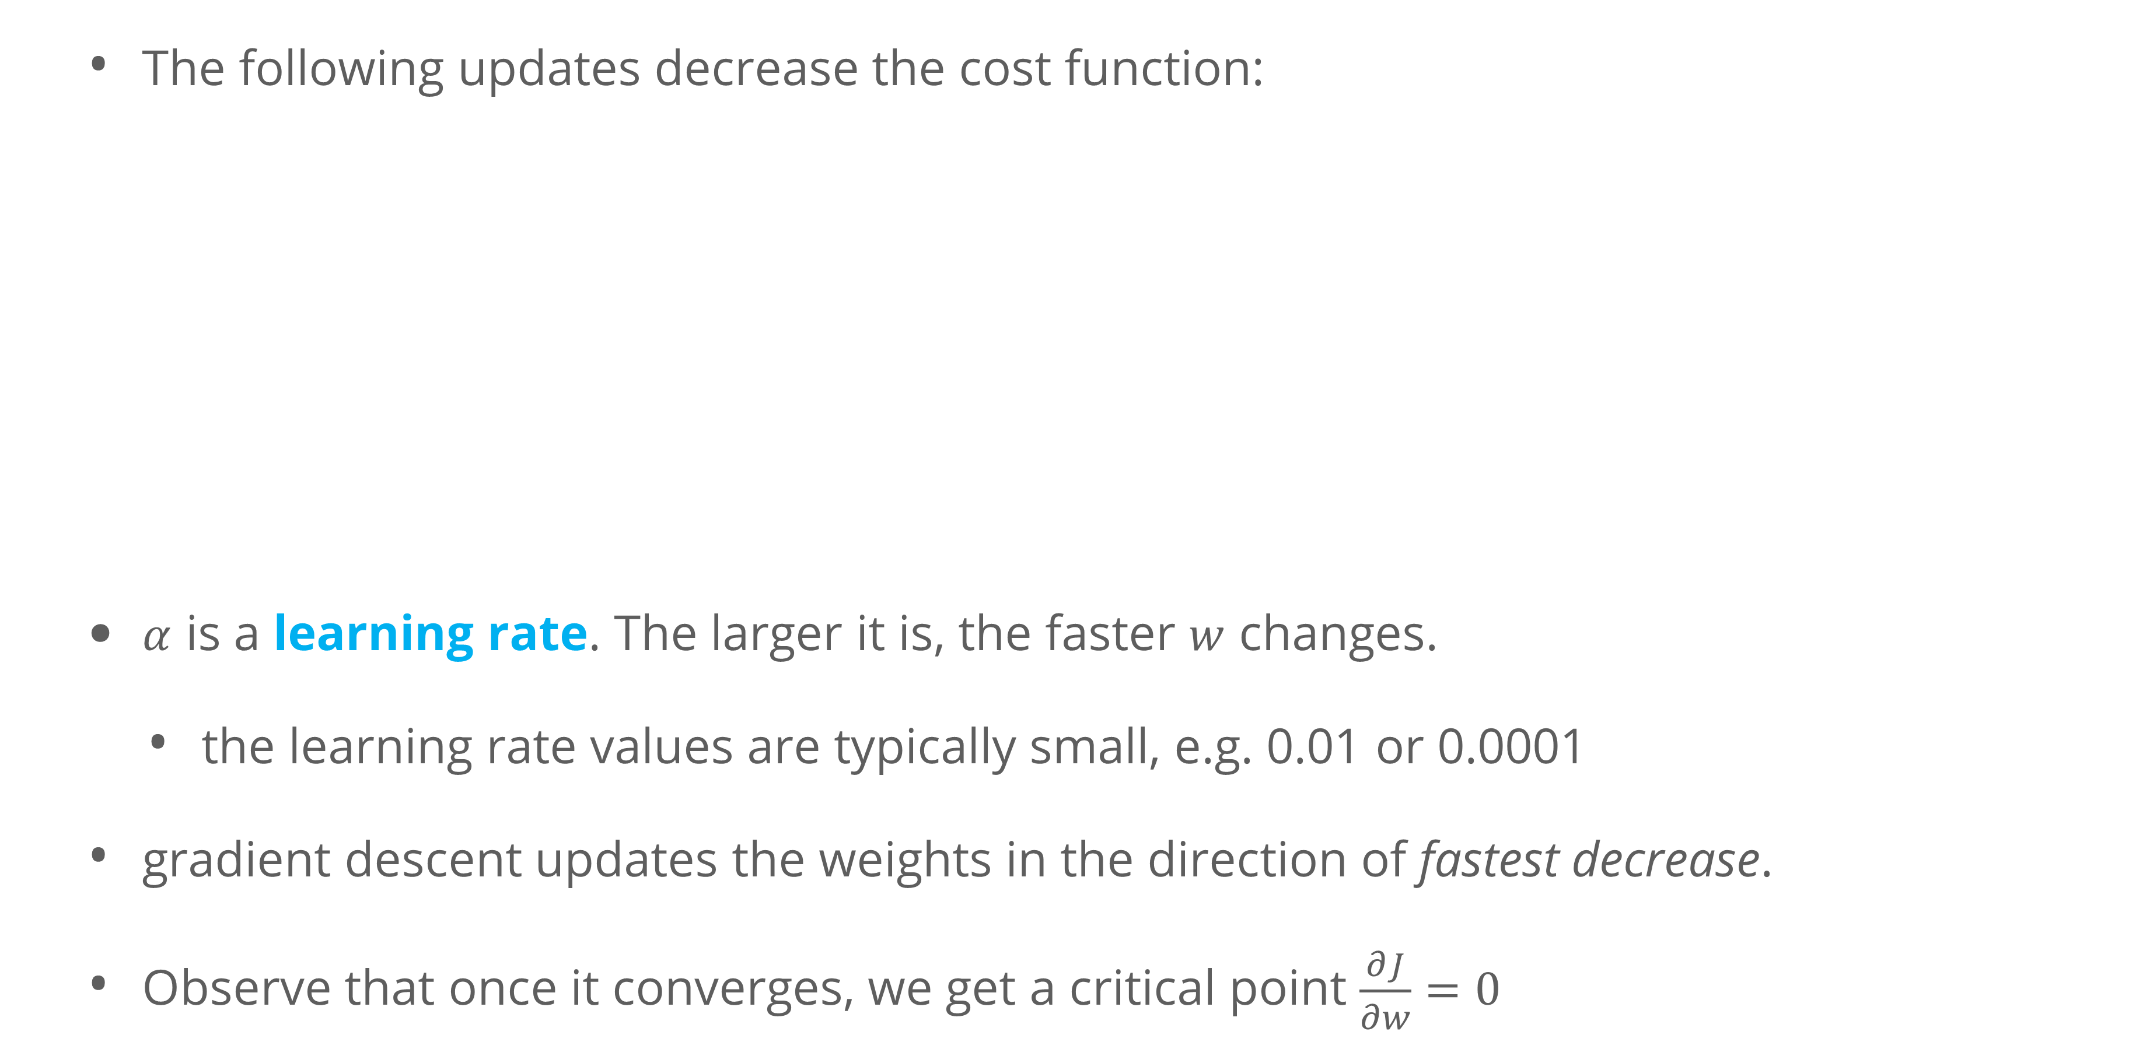
Finding the weight
Gradient Descent
The following updates decrease the cost function:
$α$ is a learning rate. The larger it is, the faster $w$ changes.
the learning rate values are typically small, e.g. 0.01 or 0.0001
gradient descent updates the weights in the direction of fastest decrease.
Observe that once it converges, we get a critical point $\frac{∂J}{∂w}=0$

Slide 30
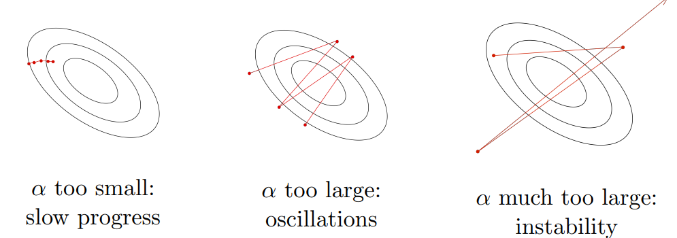
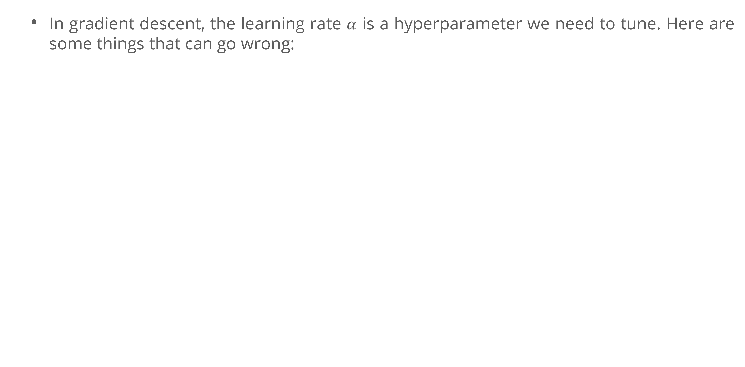
Finding the weight
Gradient Descent- Learning Rate
In gradient descent, the learning rate $α$ is a hyperparameter we need to tune. Here are some things that can go wrong:

Slide 31
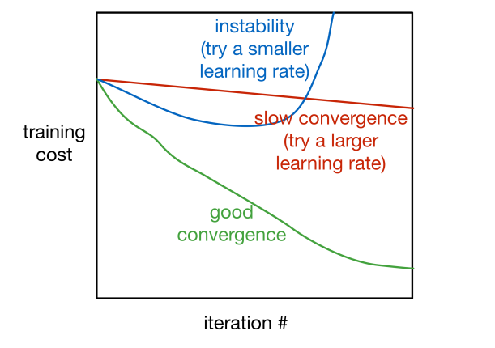
Finding the weight
Gradient Descent- Training Curve
To diagnose optimization problems, it’s useful to look at training curves: plot the training cost as a function of iteration.
Warning: it’s very hard to tell from the training curves whether an optimizer has converged. They can reveal major problems, but they can’t guarantee convergence.

Slide 32
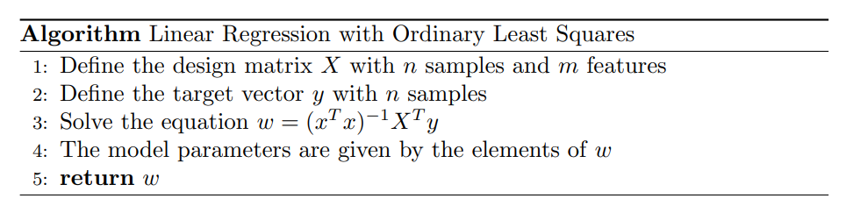
Algorithm

Slide 33
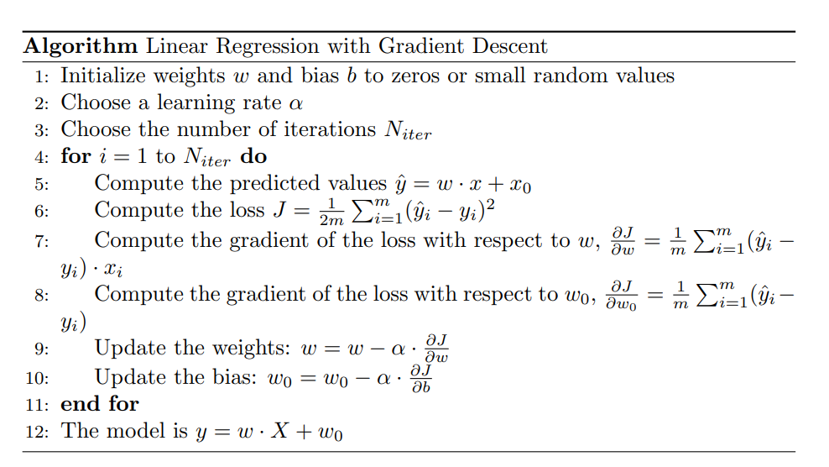
Algorithm

Slide 34
Evaluation Metric

Slide 35
Evaluation Metric
Typical evaluation metric for regression problems:
Root mean square error (RMSE)
Mean absolute error (MAE)
coefficient of determination(R²)

Slide 36
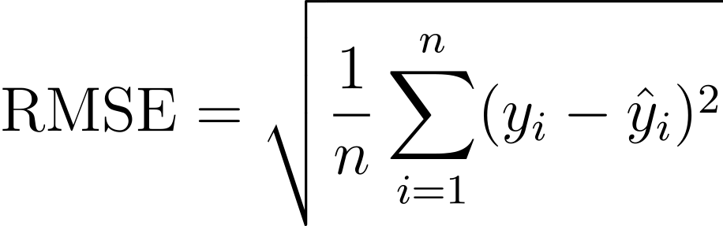
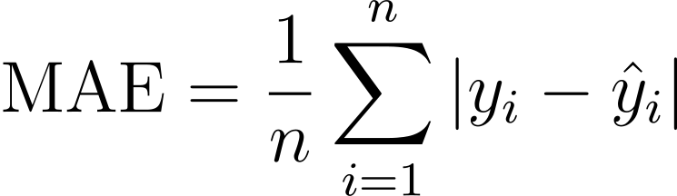
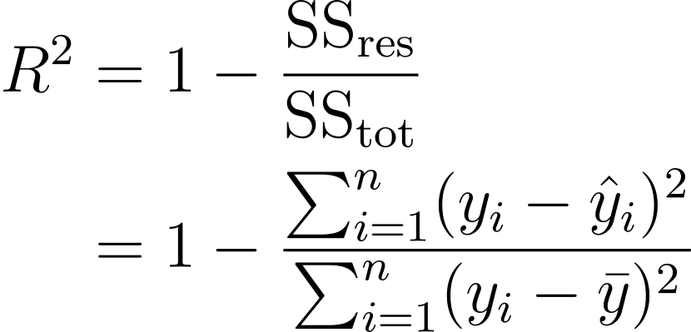
Evaluation Metric
Rmse gives an idea of how much error the system typically makes in its predictions, with a higher weight given to large error
MAE used when there are many outlier districts.
R² is a statistical measure that represents the proportion of the variance for a dependent variable that's explained by an independent variable

Slide 37
Exercise

Slide 38
Exercise
You are a data scientist tasked with developing a predictive model for house prices (https://www.kaggle.com/c/house-prices-advanced-regression-techniques) . Your objective is to build a linear regression model that accurately predicts the sale price of houses based on various features.
Split the dataset into a training set and a testing set to evaluate your model's performance (70:30).
Develop a linear regression model using your selected features.
Evaluate your model using appropriate metrics such as Mean Squared Error (MSE), Root Mean Squared Error (RMSE), or R-squared.
Interpret the results and provide insights into the model's performance.

Slide 39
References

Slide 40
References
Abhigyan, A. (2020, July 19). Understanding The Linear Regression!!!! Medium. https://medium.com/analytics-vidhya/understanding-the-linear-regression-808c1f6941c0
Bishop, C. M. (2006). Pattern recognition and machine learning. Springer.
Chang, Y., & Park, J. Y. (2012). Multivariate Linear Models. https://econ.fudan.edu.cn/__local/9/15/A1/DA682DA014DF4BBD8FF53DFB0B7_369E8B6E_17BA5.pdf?e=.pdf
Farahmand, A., & Andrews, E. A. M. (2021). Linear Regression & Gradient Descent for Optimization [Lecturer notes]. CSC 311: Introduction to Machine Learning. Retrieved November 14, 2023, from https://www.cs.toronto.edu/~bonner/courses/2021f/csc311/lectures/lec03_linear_regression.pdf
James, G., Witten, D., Hastie, T., Tibshirani, R., & Taylor, J. E. (2023). An introduction to statistical learning: With applications in Python. Springer.
Penumudy, T. (2021, January 8). Everything You Need to Know About Linear Regression. Medium. https://medium.com/analytics-vidhya/everything-you-need-to-know-about-linear-regression-750a69a0ea50

